Slide 1

Solid Architecture Design
How to plan a good project, code effectively and build an application that is easy to work with which scales efficiently
AKA – Work smart; Prevent headaches

Slide 2
Who Am I?
Avid Traveler
V School Graduate (December 2018)
Full Time Back End Lead Developer
Specialize in API Integrations + software design

Slide 3
What is S.O.L.I.D.?
An acronym
A set of software design principles
A set of industry standards
Developed for Object Oriented Programming
Equally applicable to Functional & Imperative Programming

Slide 4
Why Use S.O.L.I.D.?
Easier to plan and scope projects
Structures code in a logical manner
Promotes Reusability (DRY)
Easily ‘drag and drop’ components, logic & functions
Much faster debugging
New code rarely breaks what already works

Slide 5
S.O.L.I.D.
S - Single Responsibility Principle
O - Open-Closed Principle
L - Liskov Substitution Principle
I - Interface Segregation Principle
D - Dependency Inversion Principle

Slide 6
S = Single Responsibility Principle
A Class, Function, or Component should have one responsibility
Only do one thing, do that thing well
Referential Transparency
Why?
Let’s us swap out / replace updated functionality
Isolate Bugs faster

Slide 7
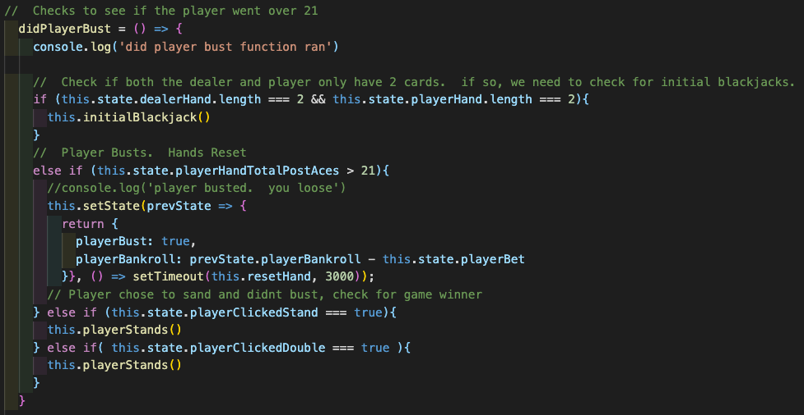
Single Responsibility - Bad Example

Slide 8
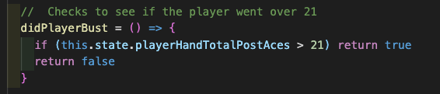
Single Responsibility - Good Example

Slide 9
O = Open / Closed Principle
A Class, Function, or Component should be open for extension but closed for modification
Write your code so that you will be able to add new functionality without changing the existing code.
Why?
Prevents situations where a change to something also requires you to adapt something existing
Scale new features faster

Slide 10
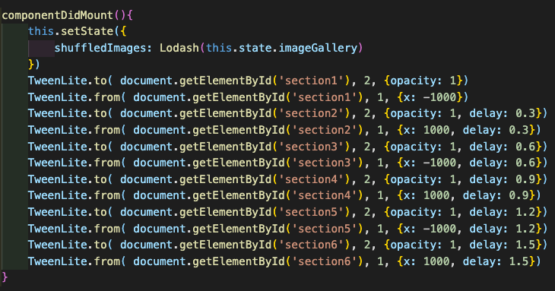
Open / Closed - Bad Example

Slide 11
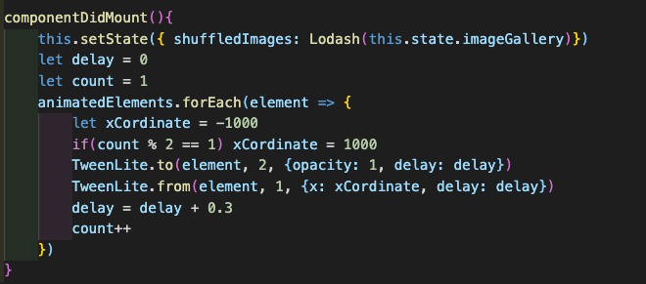
Open / Closed - Good Example

Slide 12
L = Liskov Substitution Principle
A Class, Function, or Component should be replaceable with instances of their subtypes without altering the correctness of the program
Code should be able to overwrite itself without breaking logic
Covariance
Why?
Keeps programs behaving in a predictable way
Consistent input parameters requiring less validation

Slide 13
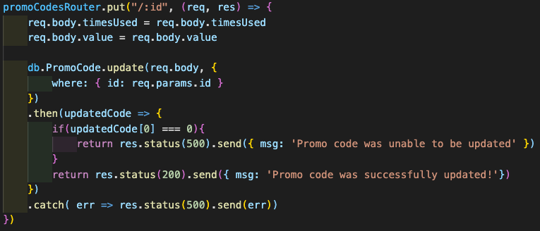
Liskov - Bad Example

Slide 14
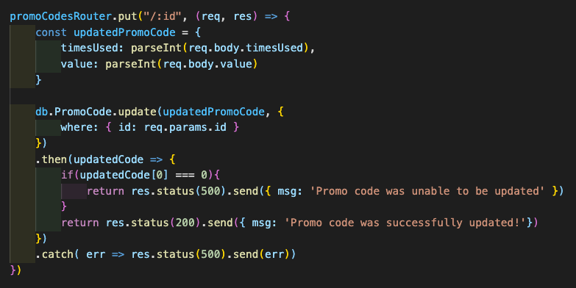
Liskov - Good Example

Slide 15
I = Interface Segregation Principle
Clients should not be forced to depend on an interface they do not use
Functions should use the smallest amount of data they require
Why?
Reduce the side effects and frequency of required changes
Split the software into multiple, independent parts

Slide 16
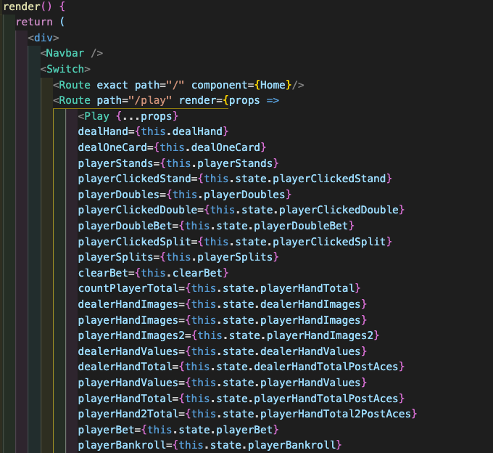
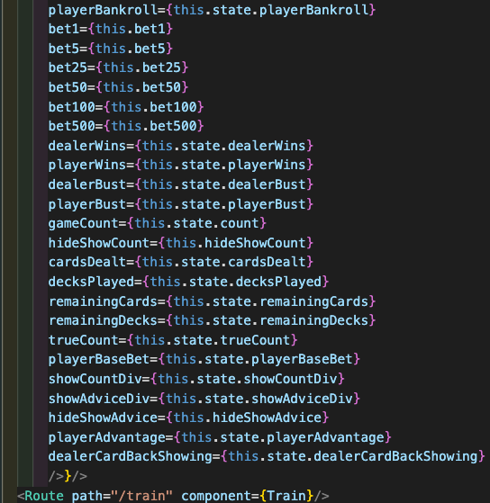
Interface Segregation - Bad Example

Slide 17
D = Dependency Inversion Principle
Program to an interface, not an implementation
Specify parameters to a function rather than hard coding the function
High-level modules or components, which provide complex logic, should be easily reusable and unaffected by changes in low-level modules
Why?
Promotes reusability of logic
Less work to write new code

Slide 18
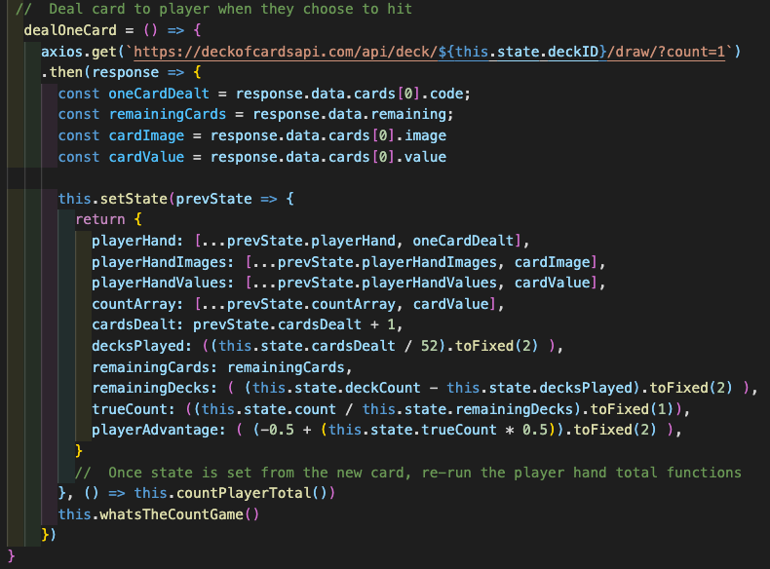
Dependency Inversion - Bad Example

Slide 19
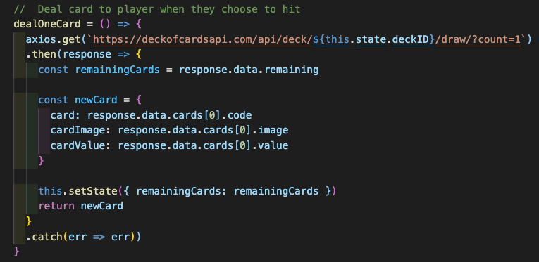
Dependency Inversion - Good Example

Slide 20
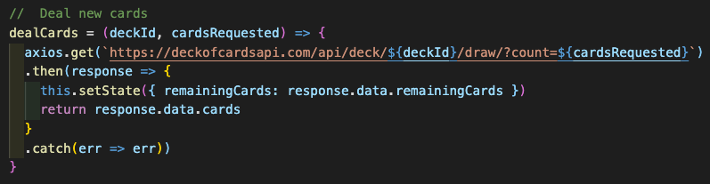
Dependency Inversion – Even Better Example

Slide 21
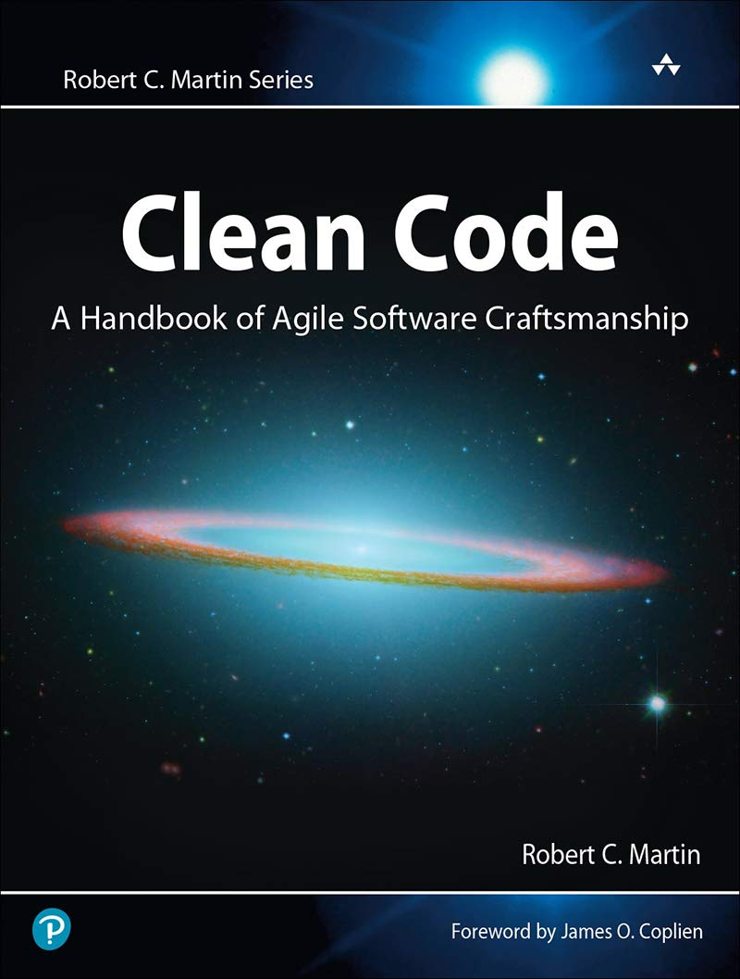
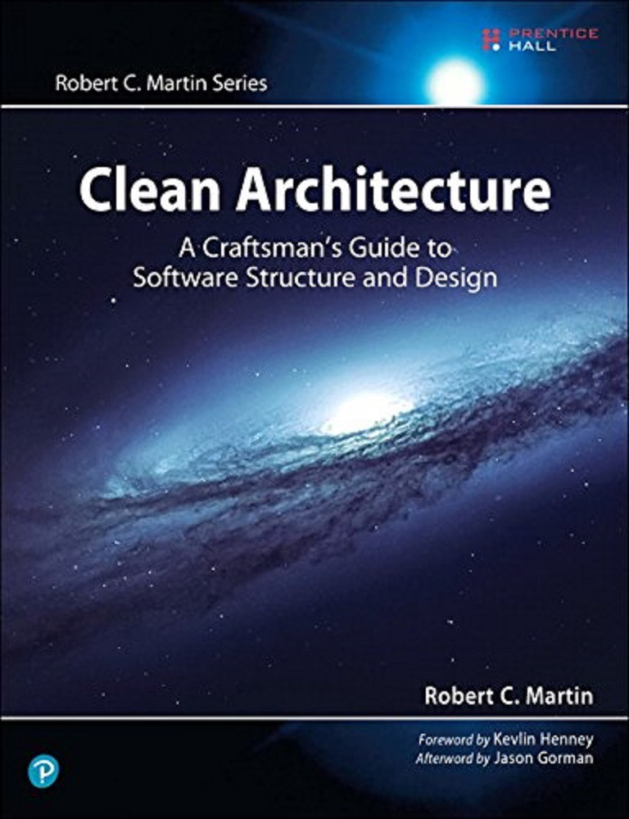

Additional Resources

Slide 22
Let’s Be Friends!
GitHub - @ Eric-Lingren
Slack - @ Eric Lingren

